Slide 1

Selecting an Appropriate Color Scheme
Notes:
How to use graphical elements to effectively label and draw the viewer’s

Slide 2
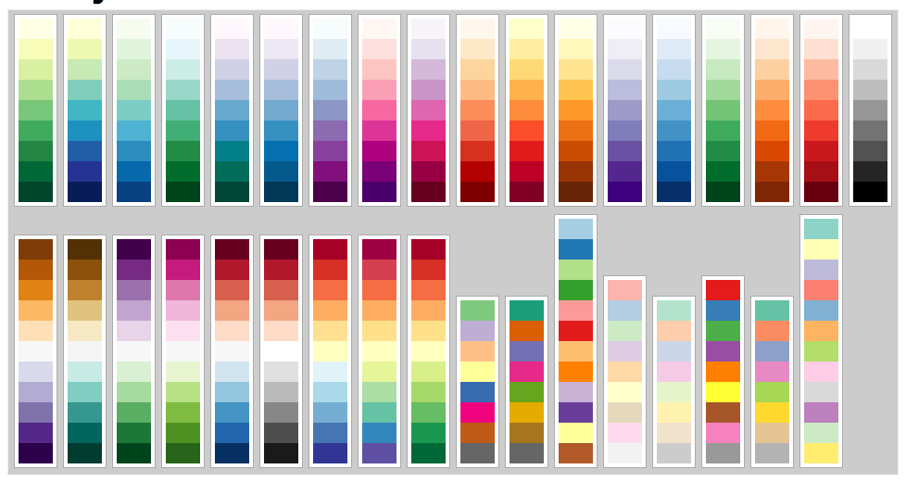
Selecting a Palette
https://bl.ocks.org/mbostock/5577023
Notes:
There is much to choose from, how to make the appropriate choice? Deeper dive …

Slide 3
Categorical
Sequential/ ordinal, ratio
Diverging
Continuous / quantitative
Notes:
categories of data types help guide color scheme selection.

Slide 4
Categorical Color Encoding
Notes:
categories of data types help guide color scheme selection.

Slide 5
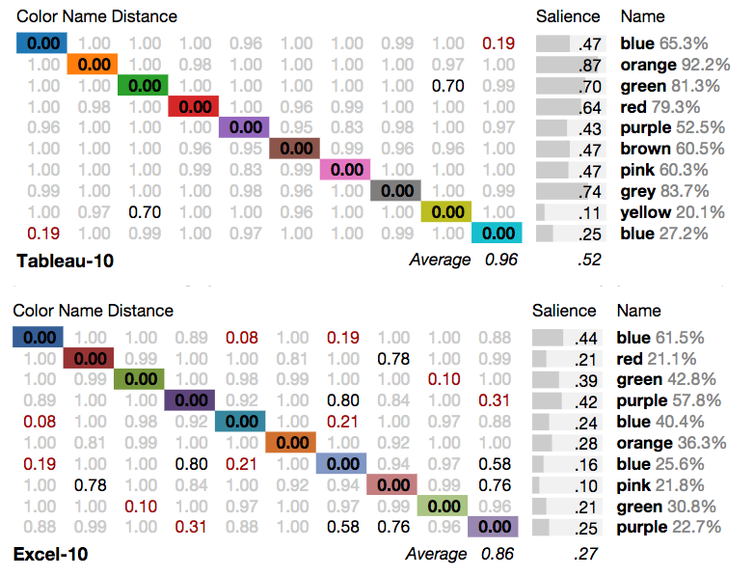
http://vis.stanford.edu/color-names/analyzer/
Notes:
Remember we ideally want unambiguous names and higher salience score. Here scores below . Have a higher degree of naming confusion.
By the way, this is perhaps one of the few instances of color used for representation that I’ll be showing.

Slide 6
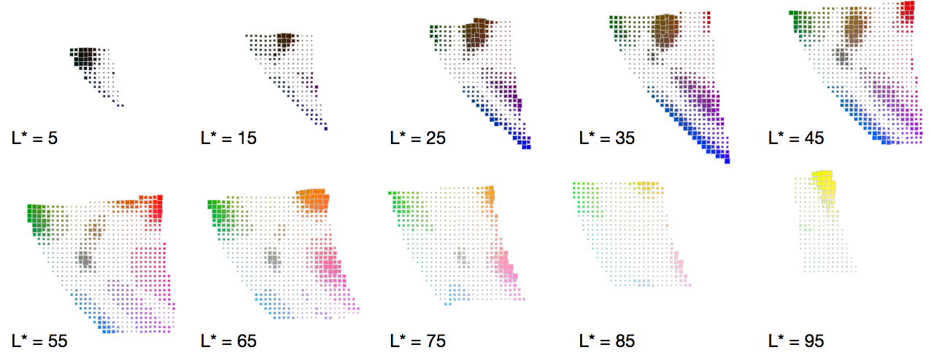
Color Saliency Map
Source: Heer, J., & Stone, M. (2012). Color naming models for color selection, image editing and palette design. In Proceedings of the SIGCHI Conference on Human Factors in Computing Systems (pp. 1007-1016). ACM.
Notes:
Each point represents a 5x5x5 bin in CIE LAB color space; with slices for every other L value shown. The area of each point is proportional to saliency meaning that larger points indicdate more consistently names colors, while smaller points show colors that have higher amounts of naming confusion. The visible areas correspond well to those basic color terms identified by Berlin and Kay … look at alogorithm here to describe further.
http://vis.stanford.edu/files/2012-ColorNameModels-CHI.pdf

Slide 7
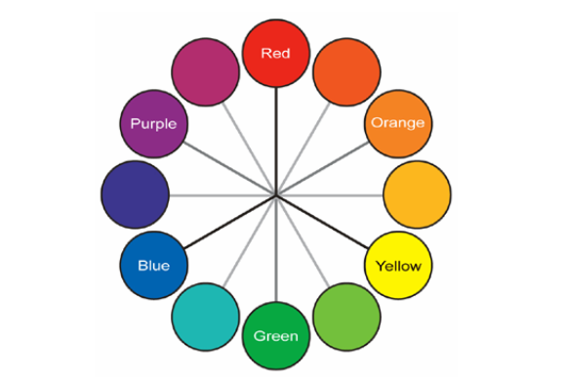
Source: Stone, M. (2016). A field guide to digital color. CRC Press.
Notes:
Add SLIDE WITH HSL BEFORE THIS.

Slide 8
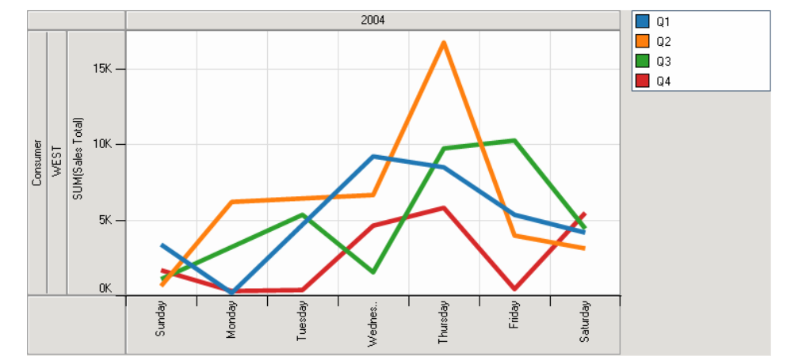
Maximized Hue Separation
Source: Stone, M. (2006). Choosing colors for data visualization. Business Intelligence Network, 2.
Notes:
Modify to be widgets instead of quarters.

Slide 9
Harmonic Colors
Source: Cohen-Or, D., Sorkine, O., Gal, R., Leyvand, T., & Xu, Y. Q. (2006, July). Color harmonization. In ACM Transactions on Graphics (TOG) (Vol. 25, No. 3, pp. 624-630). ACM.
Notes:
harmonic templates on the hue wheel. A collection of
colors that fall into the gray areas is considered to be harmonic.
The templates may be rotated by an arbitrary angle. The sizes of
the sectors are specified in the Append
https://pdfs.semanticscholar.org/2429/5f6dfa2f2d1b32faf3548f49e86539af1d12.pdf

Slide 10
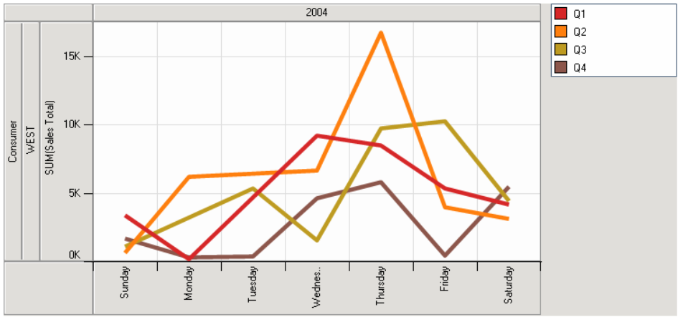
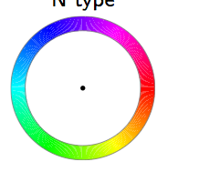
Analogous, Still Distinct
Source: Stone, M. (2006). Choosing colors for data visualization. Business Intelligence Network, 2.

Slide 11
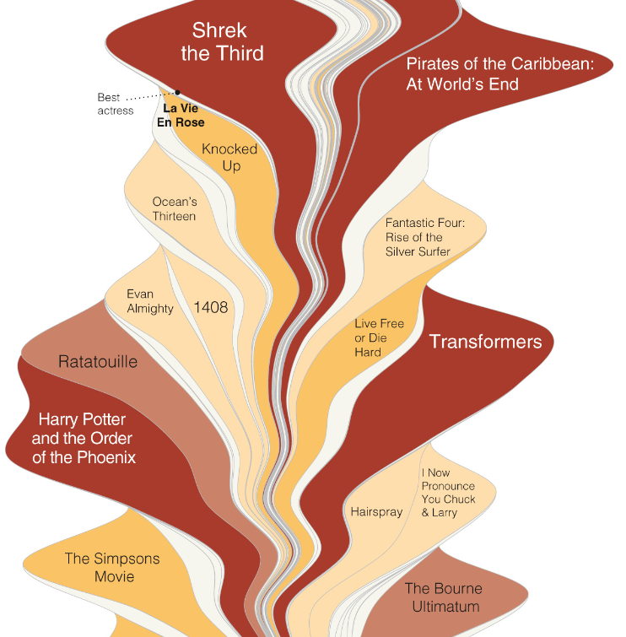
Byron & Wattenberg, 2008
Notes:
It’s not always easy, here aesthetic is balanced with the encoding but the colors have no comparitive meaning. When I look at this at first glance I do wonder what The Bourne Ultimatium shares in common with Ratatouille.

Slide 12
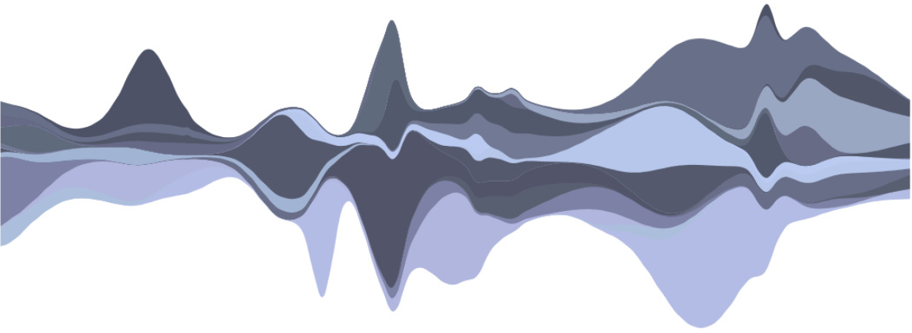
Source: Byron, L., & Wattenberg, M. (2008). Stacked graphs–geometry & aesthetics. IEEE transactions on visualization and computer graphics, 14(6).
Notes:
What about this. I’m guessing the even more subdued hue would prevent some , but I would want to conduct a study to verify this myself.

Slide 13
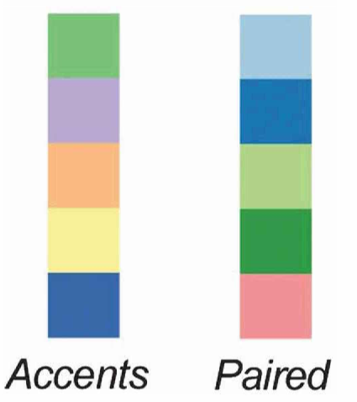
Source: Harrower, M., & Brewer, C. A. (2003). ColorBrewer. org: an online tool for selecting colour schemes for maps. The Cartographic Journal, 40(1), 27-37.
Notes:
Can be used to emphasis a certain data class or to pair two together. Though again test and consider which is more noticeable.

Slide 14
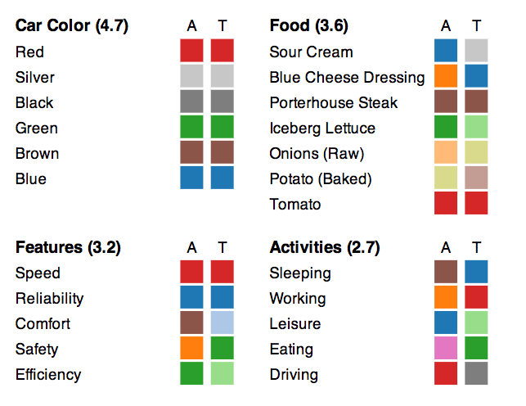
Semantically Resonant Colors
Source: Lin, S., Fortuna, J., Kulkarni, C., Stone, M., & Heer, J. (2013). Selecting Semantically‐Resonant Colors for Data Visualization. In Computer Graphics Forum (Vol. 32, No. 34, pp. 401-410).
Notes:
Use of algorithms and Mturkers to create more resonant colors
http://vis.stanford.edu/files/2013-SemanticColor-EuroVis.pdf

Slide 15
Ordinal / Sequential Color Schemes

Slide 16
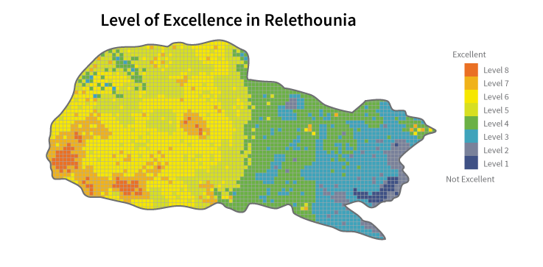
Source: https://infoactive.co/data-design

Slide 17
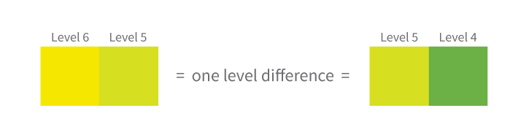
https://infoactive.co/data-design

Slide 18
Classification Methods
Manual or defined interval
Equal interval
Quantile
Natural breaks (Jenks)
Geometrical interval
Standard deviation
Source: http://pro.arcgis.com/en/pro-app/help/mapping/symbols-and-styles/data-classification-methods.htm
Notes:
Quantiles is the recommended. Classification (Jenks’ “natural breaks”)

Slide 19
Classification Methods
Manual or defined interval
Equal interval
Quantile
Natural breaks (Jenks)
Geometrical interval
Standard deviation
Source: http://pro.arcgis.com/en/pro-app/help/mapping/symbols-and-styles/data-classification-methods.htm
Notes:
Quantiles is the recommended. Classification (Jenks’ “natural breaks”)

Slide 20
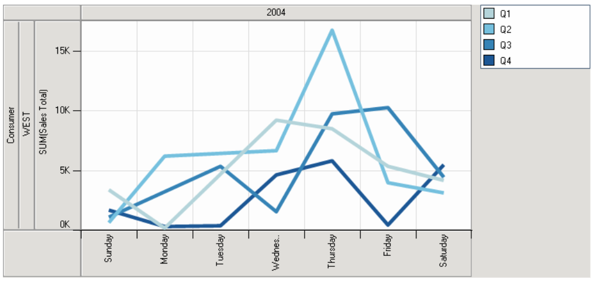
Sequential Encoding
Source: Stone, M. (2006). Choosing colors for data visualization. Business Intelligence Network, 2.

Slide 21
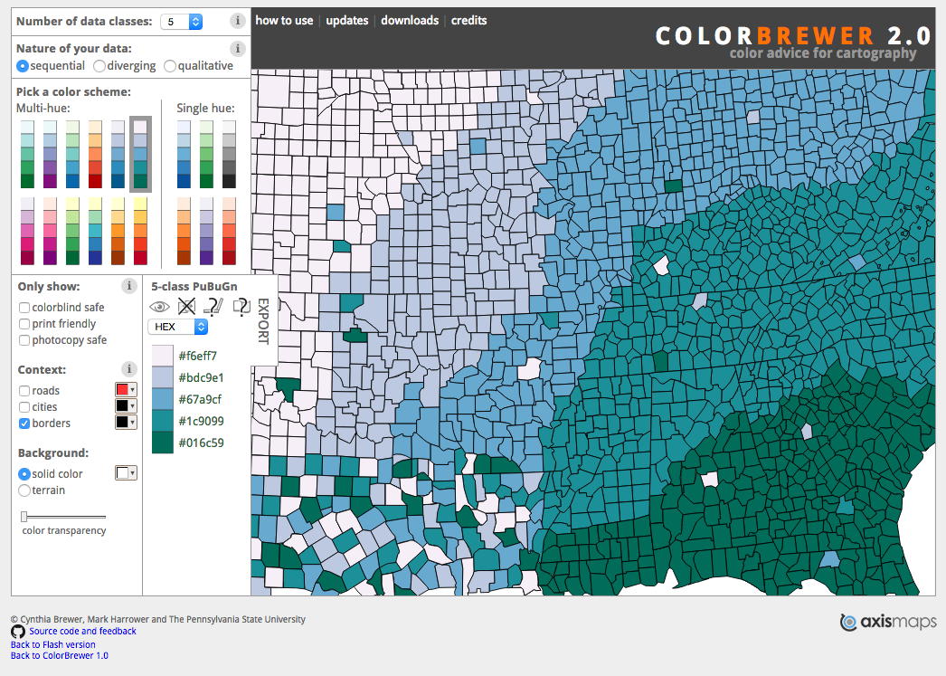
http://colorbrewer2.org/
Notes:
Color Brewer, while made for thematic maps has useful choices for a wide array of color schemas for vis. Though you will still want to put some thought into what works best for you vis of course (and test it)

Slide 22
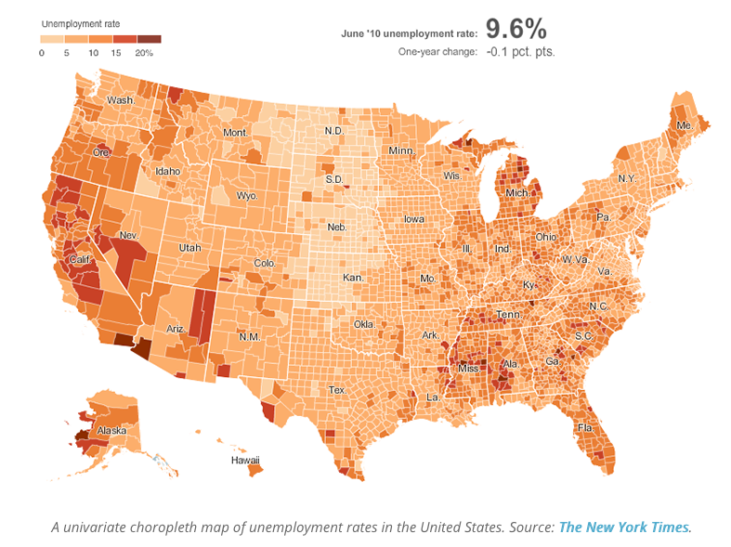

Slide 23
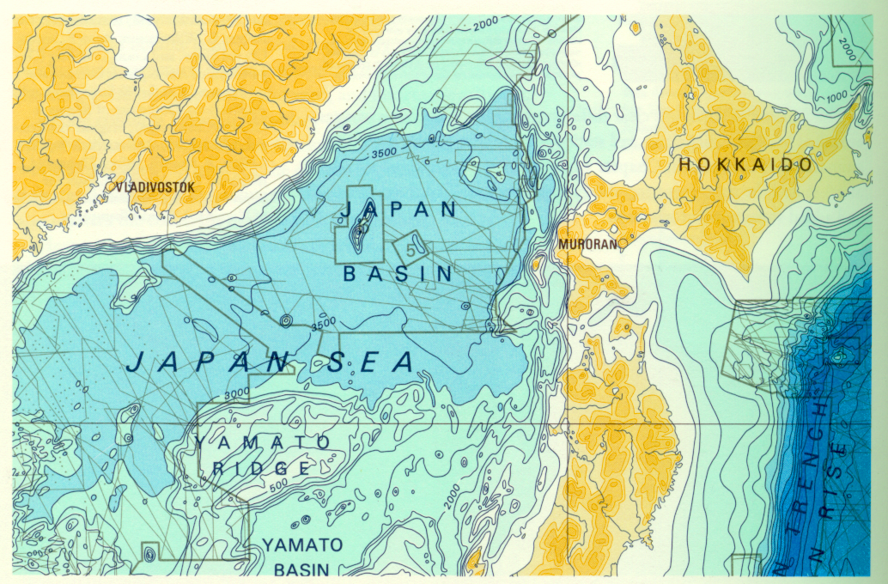
Discontinuous Colors with Contours
Tufte, 1997
Notes:
discontinuous colors with contours good for interval and ratio data

Slide 24
Diverging Color Schemes

Slide 25
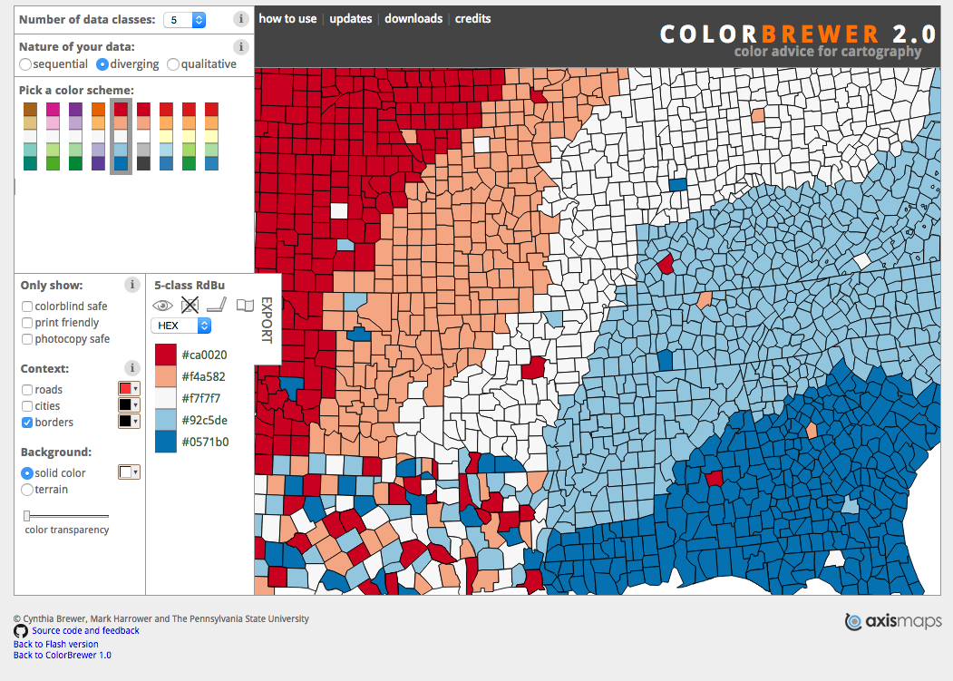
http://colorbrewer2.org/

Slide 26
Continuous / Quantitative Color Schemes

Slide 27
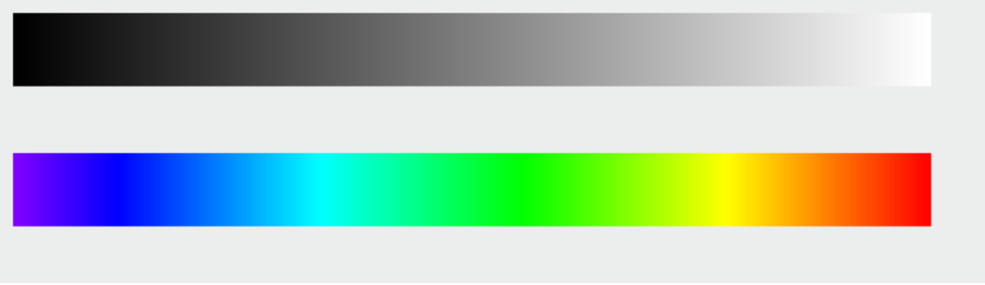
Source: http://earthobservatory.nasa.gov/blogs/elegantfigures/2013/08/

Slide 28
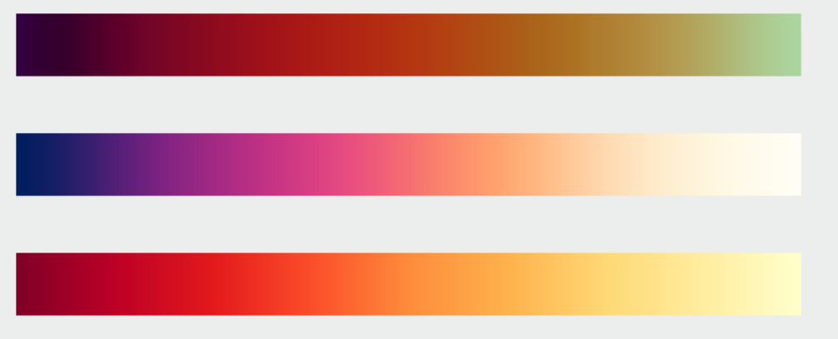
Source: http://earthobservatory.nasa.gov/blogs/elegantfigures/2013/08/

Slide 29
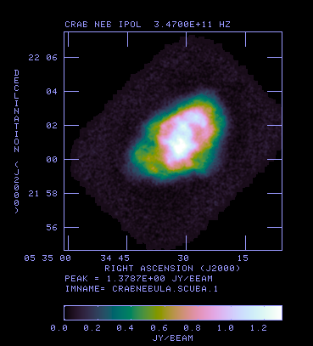
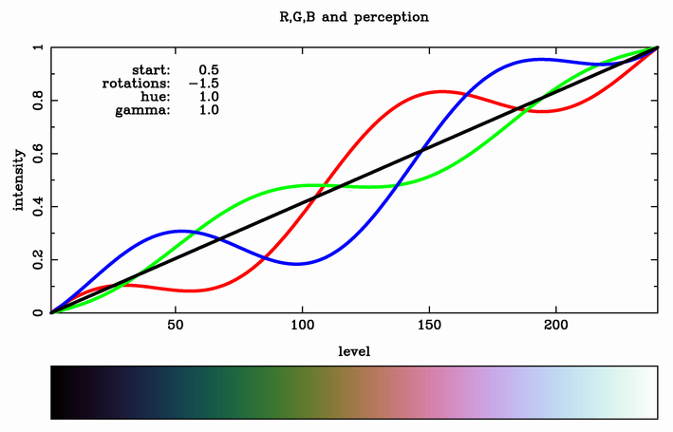
Cubehelix
Diagram Source:
https://www.mrao.cam.ac.uk/~dag/CUBEHELIX/
Python Version: https://www.mrao.cam.ac.uk/~dag/CUBEHELIX/cubehelix.py

Slide 30
Areas to Consider
Categorical:
Distinctive
Consider harmonious groupings
Pairings or representations
Sequential:
Limit hue, use luminance & saturation
Higher values to darker
Diverging:
Use when data has a meaningful midpoint
Use white/ gray neutral for midpoint
More saturated for endpoints
Continuous:
Beware the rainbow
Use saturation and luminance

Slide 31
Additional Cases

Slide 32
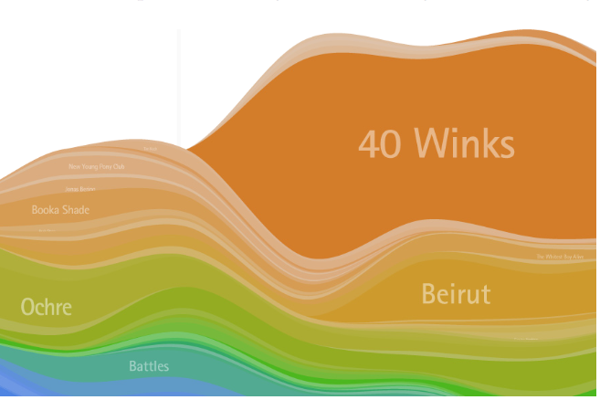
Source: Byron, L., & Wattenberg, M. (2008). Stacked graphs–geometry & aesthetics. IEEE transactions on visualization and computer graphics, 14(6).
Notes:
Here we have Are 40 winks more related to Beirut than to Ochre
https://pdfs.semanticscholar.org/29a1/b10bae922ccb6a2d3f40958bcc1b70c5fbc1.pdf
For Listening History, the
colors chosen to represent the
spectrum of old to new, of most
significant, or most listened, to
least significant construct a two
dimensional gradient (
fig 9
). The
gradient across the x axis is a
detailed movement through hue
representing the “cold core” of
known musicians versus the “hot
new” discoveries of recent musi
-
cians, while the gradient down
the y axis represents significant
to not significant, consistently decreasing in saturation and increas
-
ing slightly in brightness.

Slide 33
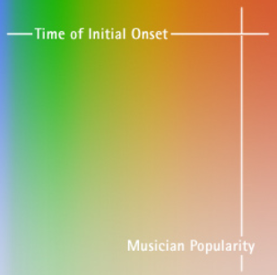
Source: Byron, L., & Wattenberg, M. (2008). Stacked graphs–geometry & aesthetics. IEEE transactions on visualization and computer graphics, 14(6).
Notes:
Here we have Are 40 winks more related to Beirut than to Ochre
For Listening History, the
colors chosen to represent the
spectrum of old to new, of most
significant, or most listened, to
least significant construct a two
dimensional gradient (
fig 9
). The
gradient across the x axis is a
detailed movement through hue
representing the “cold core” of
known musicians versus the “hot
new” discoveries of recent musi
-
cians, while the gradient down
the y axis represents significant
to not significant, consistently decreasing in saturation and increas
-
ing slightly in brightness.

Slide 34
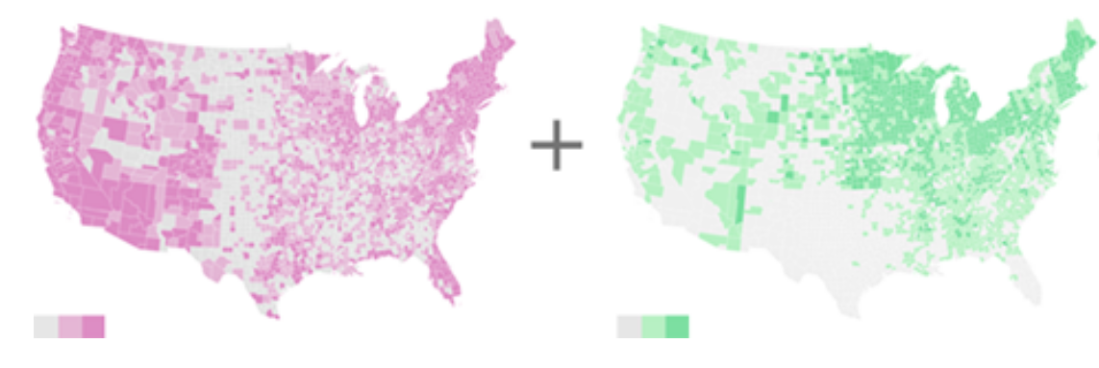
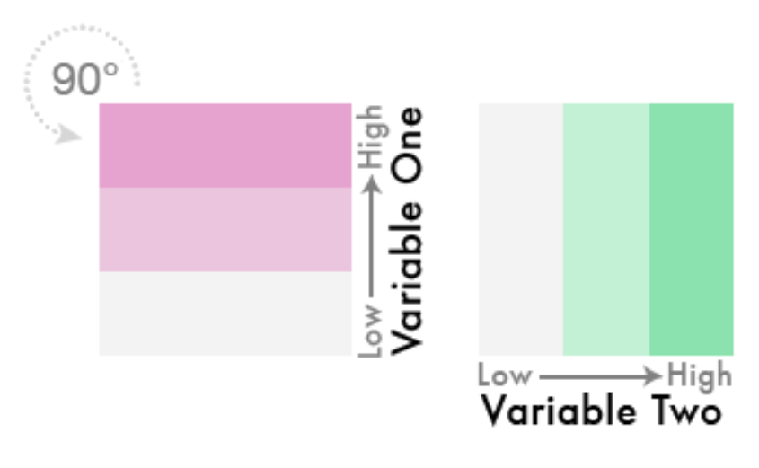
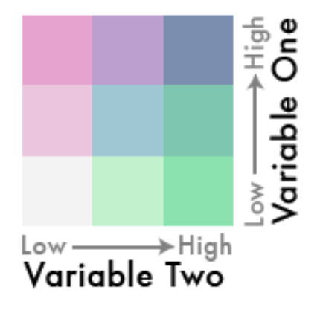
Diverging Bivariate
Source: http://www.joshuastevens.net/cartography/make-a-bivariate-choropleth-map/

Slide 35
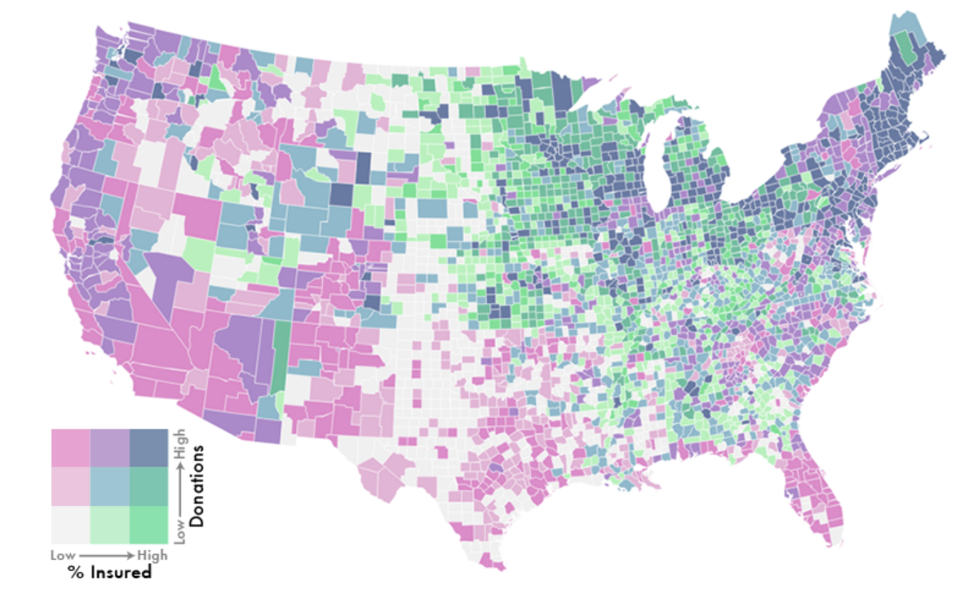
Diverging Bivariate
Source: http://www.joshuastevens.net/cartography/make-a-bivariate-choropleth-map/
Notes:
What happens when take off glasses and attentive?
http://www.joshuastevens.net/cartography/make-a-bivariate-choropleth-map/

Slide 36
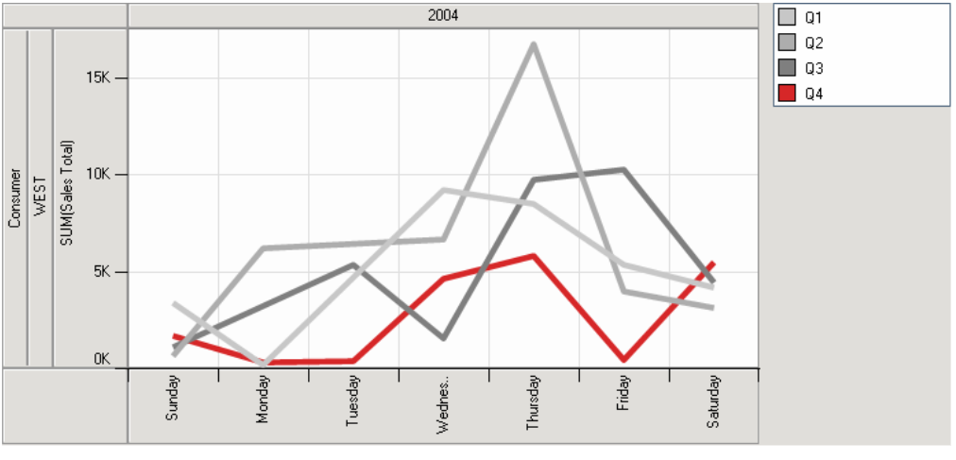
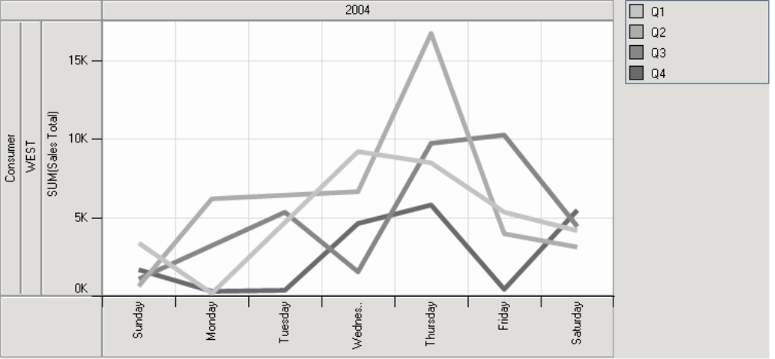
Source: Stone, M. (2006). Choosing colors for data visualization. Business Intelligence Network, 2.

Slide 37
Source: Stone, M. (2006). Choosing colors for data visualization. Business Intelligence Network, 2.

Slide 38
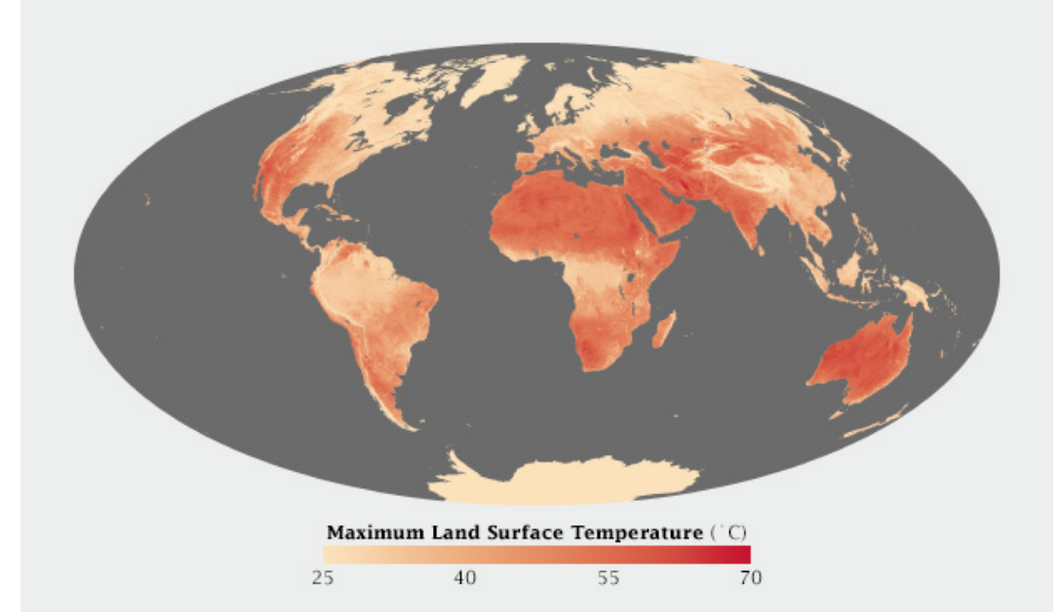
Source: http://earthobservatory.nasa.gov/blogs/elegantfigures/2013/08/
Notes:
Representational association with earth’s hottest places

Slide 39
Tools
Colorbrewer: http://colorbrewer2.org/​
Chroma.js: http://gka.github.io/palettes​
​
D3 built-ins: https://github.com/d3/d3-color​
Adobe: https://color.adobe.com/create/color-
wheel

Slide 40


